Slide 1
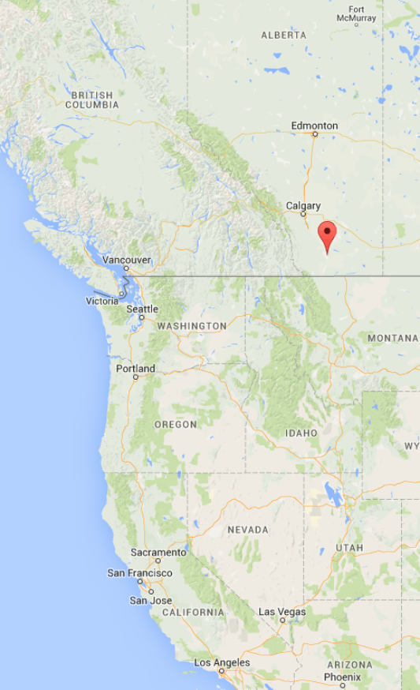

Introduction to Deep Learning
Lectured by Shangsong Liang
Sun Yat-sen University
Originally Produced by Dr. Artur Luczak, Canadian Centre for Behavioural Neuroscience
University of Lethbridge, AB, Canada
http://lethbridgebraindynamics.com/artur_luczak

Slide 2
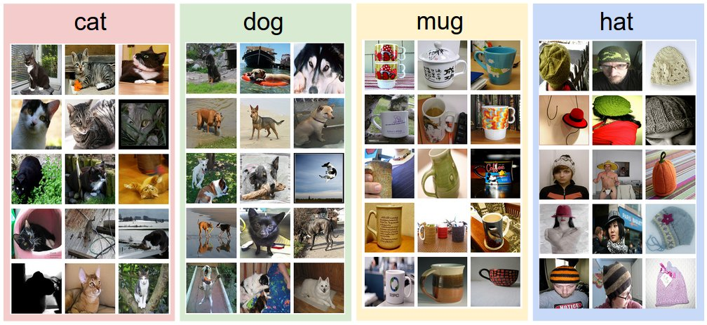
google inception network
Deep Learning is providing breakthrough results in speech recognition, image classification, etc.

Slide 3
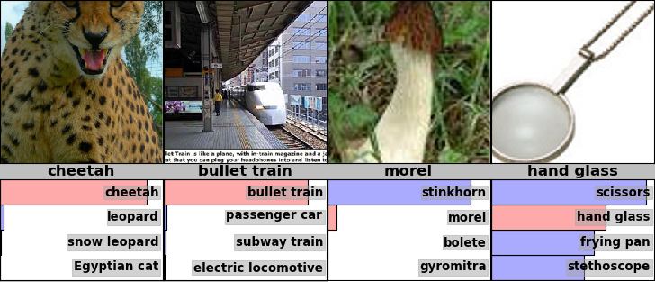
Examples from the test set (with the network’s guesses)

Slide 4
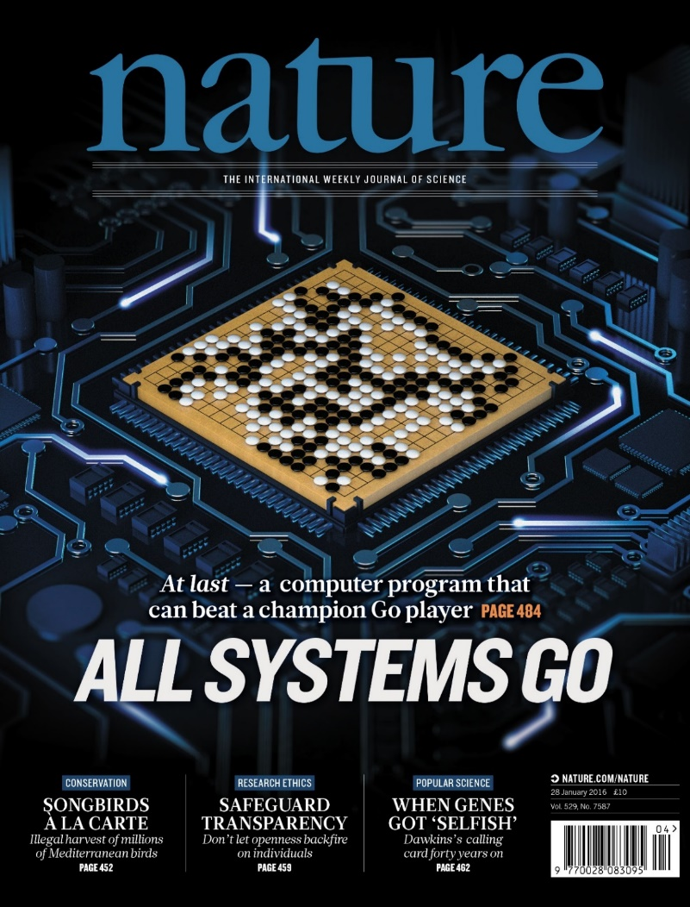
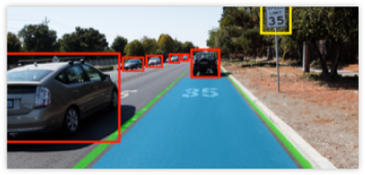
Video analyses and decision making

Slide 5
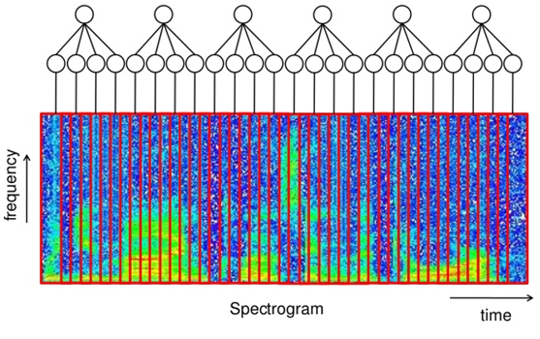
Speech recognition

Slide 6
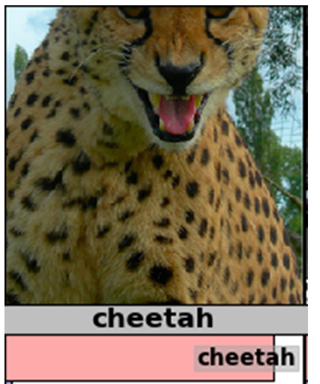
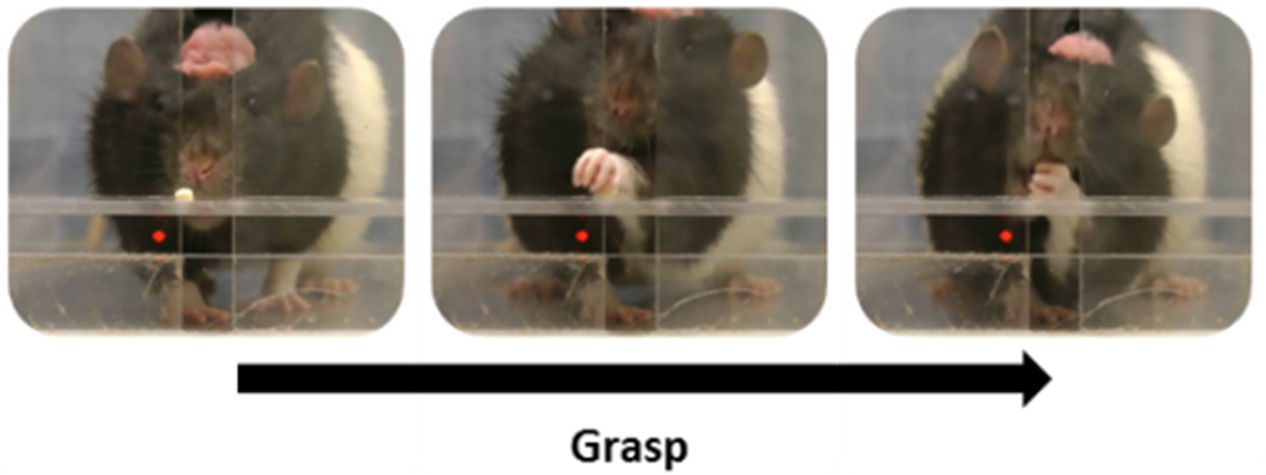
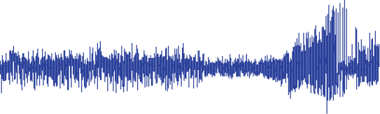
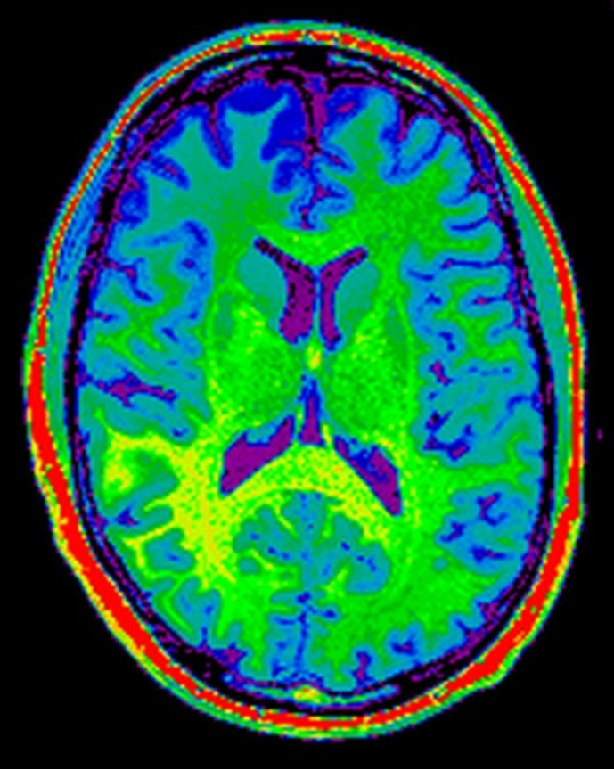
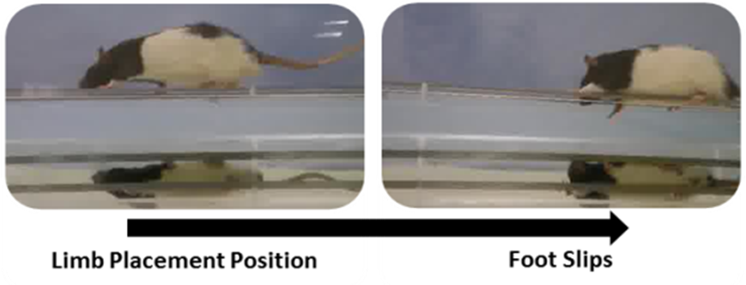
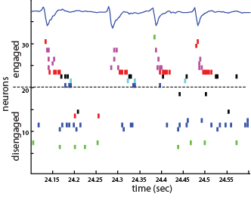
Neuroscience data is similar to other types of data
EEG / LFP
Spiking data
Ryait et al. & Luczak

Slide 7
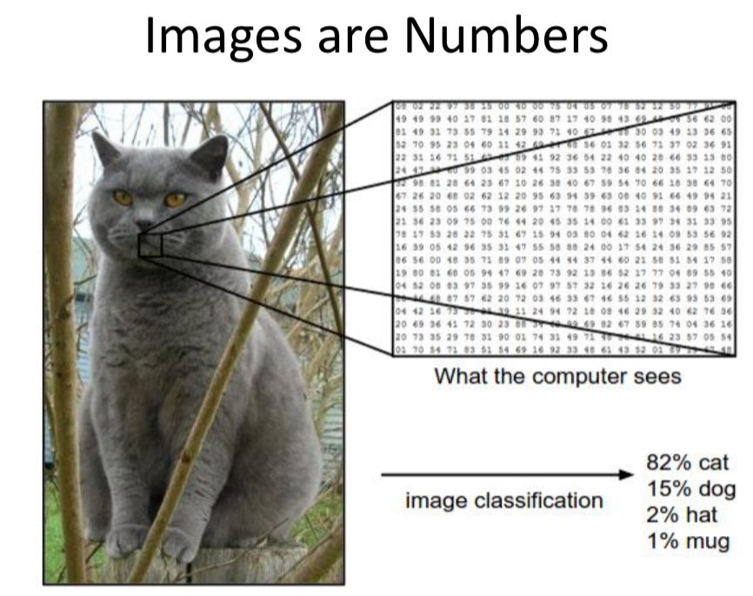

Slide 8
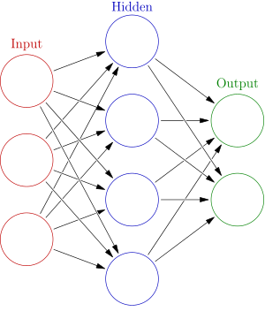
What is Artificial Neuronal Network?

Slide 9
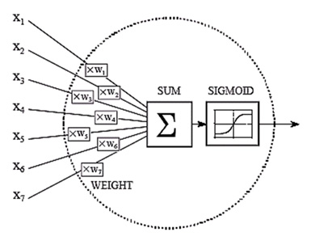
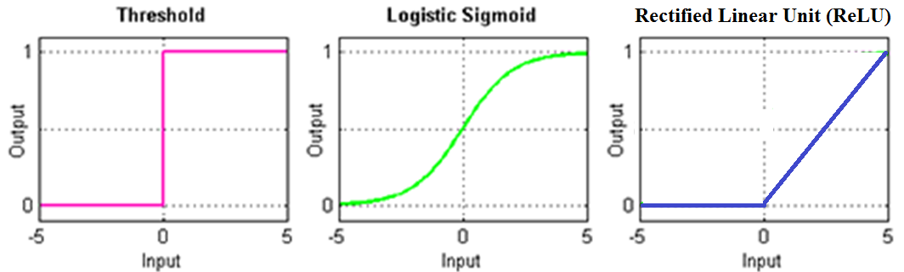
Artificial neural

Slide 10
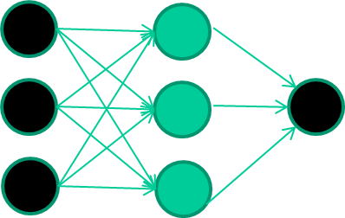
Training Artificial Neural network
Training data
Fields class
1.4 2.7 1.9 0
3.8 3.4 3.2 0
6.4 2.8 1.7 1
4.1 0.1 0.2 0
etc …
Initialise with random weights
https://www.macs.hw.ac.uk/~dwcorne/Teaching/introdl.ppt

Slide 11
Training data
Fields class
1.4 2.7 1.9 0
3.8 3.4 3.2 0
6.4 2.8 1.7 1
4.1 0.1 0.2 0
etc …
Present a training pattern
1.4
2.7
1.9

Slide 12
Training data
Fields class
1.4 2.7 1.9 0
3.8 3.4 3.2 0
6.4 2.8 1.7 1
4.1 0.1 0.2 0
etc …
Feed it through to get output
1.4
2.7 0.8
1.9

Slide 13
Training data
Fields class
1.4 2.7 1.9 0
3.8 3.4 3.2 0
6.4 2.8 1.7 1
4.1 0.1 0.2 0
etc …
Compare with target output
1.4
2.7 0.8
0
1.9 error 0.8

Slide 14


Training data
Fields class
1.4 2.7 1.9 0
3.8 3.4 3.2 0
6.4 2.8 1.7 1
4.1 0.1 0.2 0
etc …
Adjust weights based on error
1.4
2.7 0.8
0
1.9 error 0.8

Slide 15
Training data
Fields class
1.4 2.7 1.9 0
3.8 3.4 3.2 0
6.4 2.8 1.7 1
4.1 0.1 0.2 0
etc …
And so on ….
6.4
2.8 0.9
1
1.7 error -0.1
Repeat this thousands, maybe millions of times – each time
taking a random training instance, and making slight
weight adjustments
Algorithms for weight adjustment are designed to make
changes that will reduce the error

Slide 16
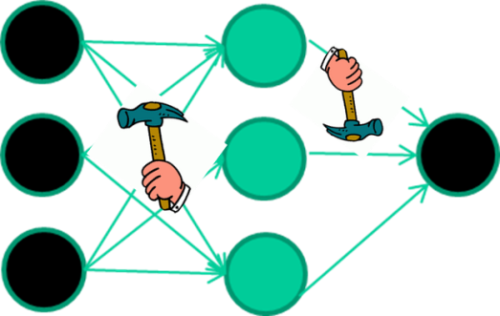
weight-learning algorithms for NNs work by making thousands and thousands of tiny adjustments, each making the network do better at the most recent pattern, but perhaps a little worse on many others
eventually this tends to be good enough to learn effective classifiers for many real applications

Slide 17
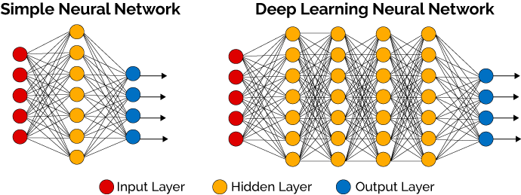
What is deep learning ?
A network with 1 hidden layer can, in theory, learn perfectly any classification problem. A set of weights exists that can produce the targets from the inputs. The problem is finding them.

Slide 18
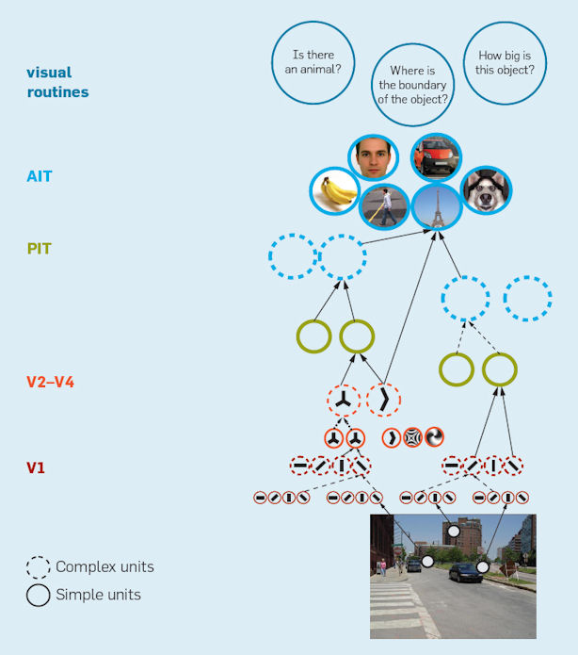
Hierarchical models
Riesenhuber & Poggio. Nature Neurosci 1999

Slide 19
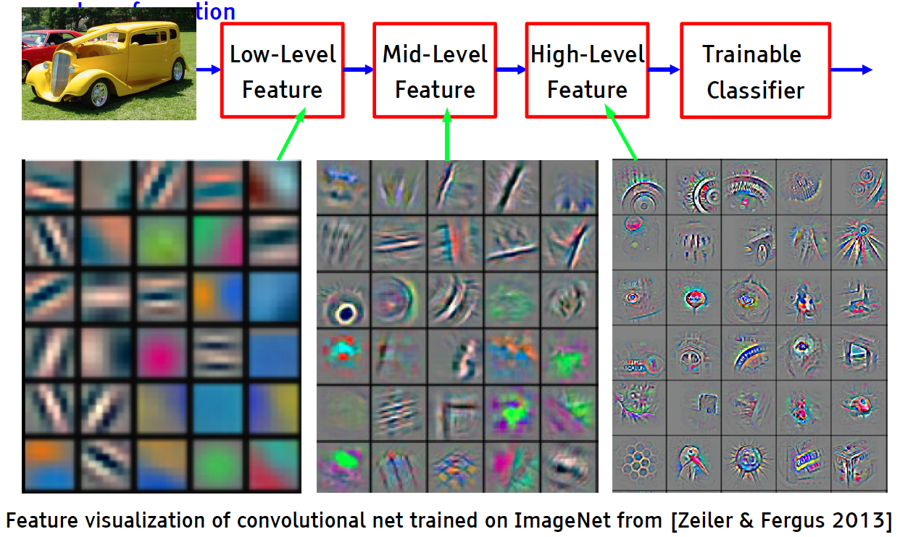
Deep Learning = Learning Hierarchical Representations

Slide 20
Convolutional Networks (ConvNet or CNN)
(currently the dominant approach for neural networks)
Use many different copies of the same feature detector with different positions.
  Replication greatly reduces the number of free parameters to be learned.
Use several different feature types, each with its own map of replicated detectors.
  Allows each patch of image to be represented in several ways.

Slide 21
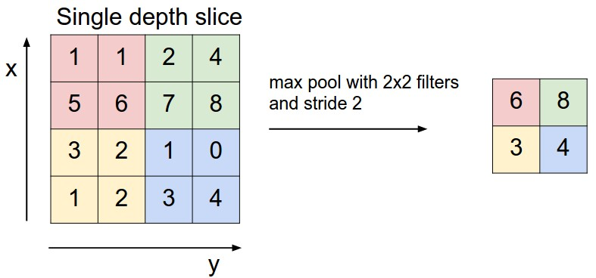
CNN Architecture: Pooling Layer
Pooling partitions the input image into a set of non-overlapping rectangles and, for each such sub-region, outputs the maximum value of the features in that region.
Intuition: to progressively reduce the spatial size of the representation to reduce the amount of parameters and computation in the network, and hence to also control overfitting
9
0
3
9
0

Slide 22
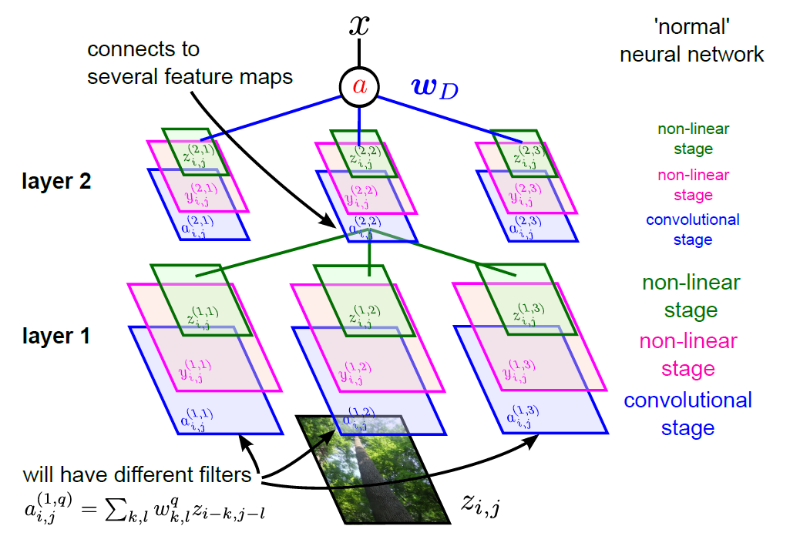
Full CNN
pooling
pooling

Slide 23
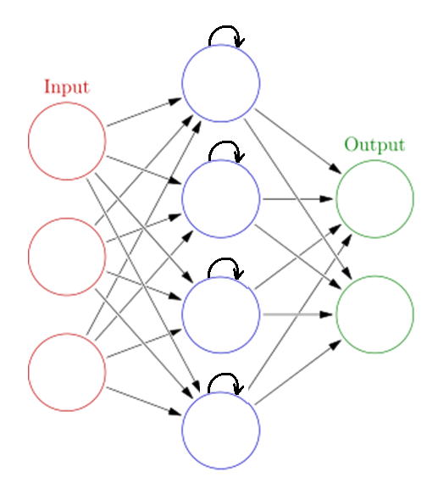
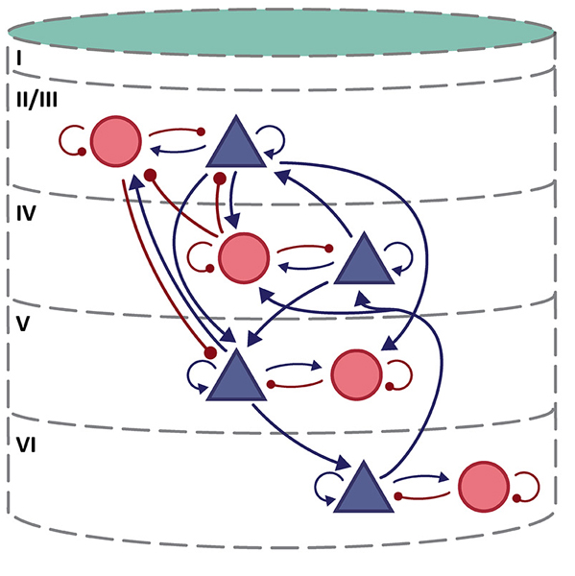
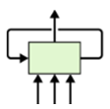
Recurrent Neural Networks and LSTM neurons
Potjans and Diesmann (2014)
Note: No top-down feedback connections from top layers

Slide 24
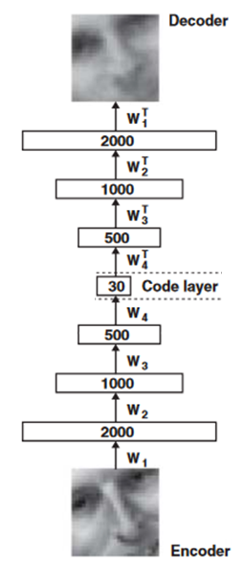
Autoencoder
Train the neural network to reproduce its input vector as its output
This forces it to compress as much information as possible into few numbers in the central bottleneck.
These few (here 30) numbers are then a good way to represent data.

Slide 25
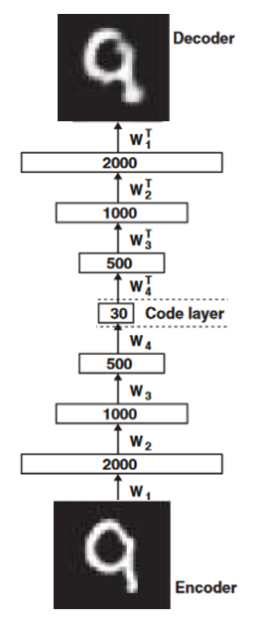
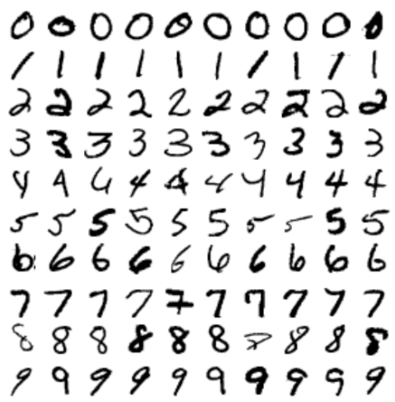
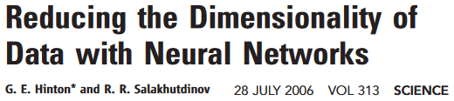
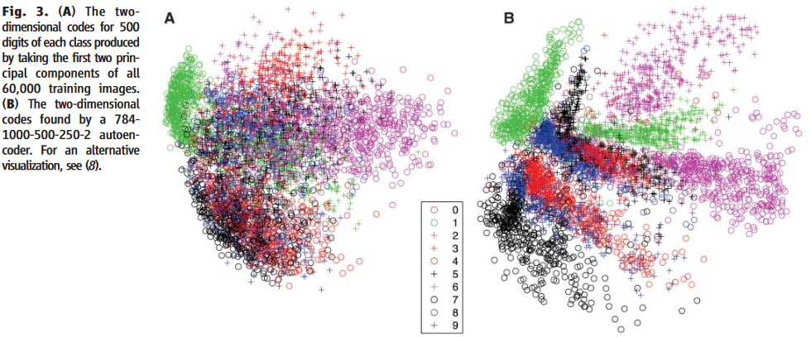
Autoencoder

Slide 26
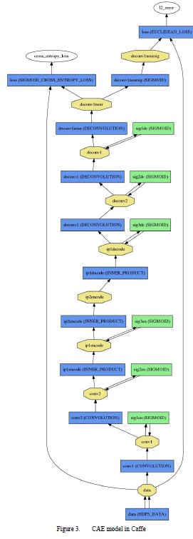
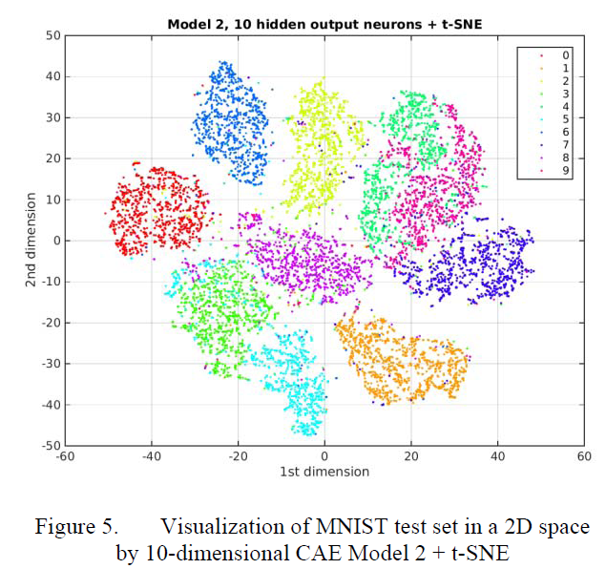
Convolutional Autoencoder
Turchenko & Luczak, IEEE IDAACS 2017

Slide 27
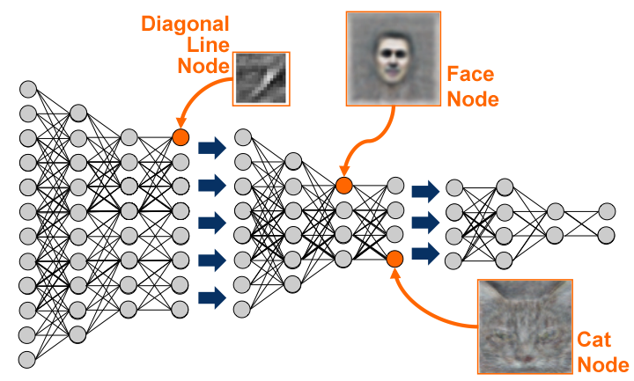
Deep Neuronal Networks
Le et al. (2013) ICASSP, IEEE International Conference
http://theanalyticsstore.ie/deep-learning/

Slide 28
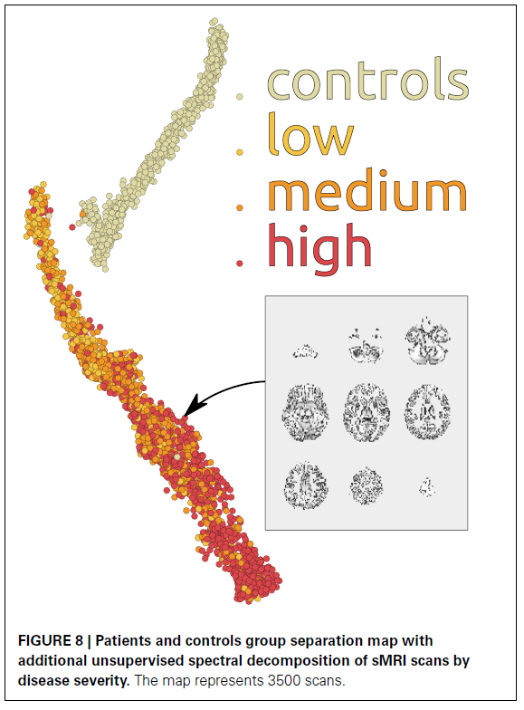
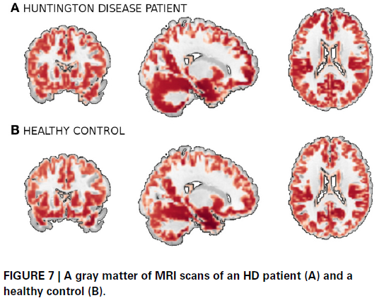
Visualizing MRI scans using autoencoder
Plis et al. Front. Neurosci. 2014

Slide 29
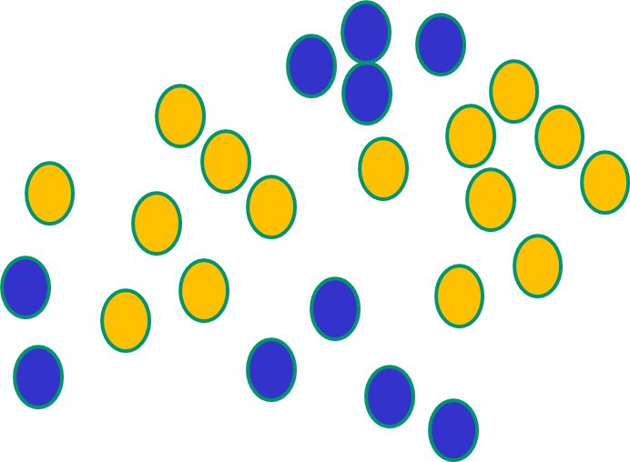
1) Non-linearity
2) self-learned features
Why Neural Networks are generally better than other methods?
Linear method
Non-linear method

Slide 30
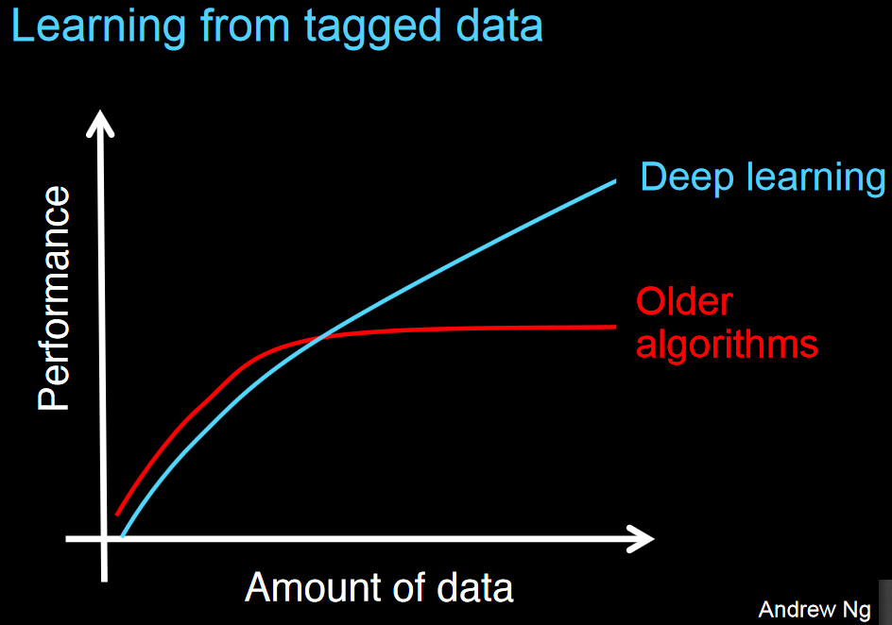

Slide 31
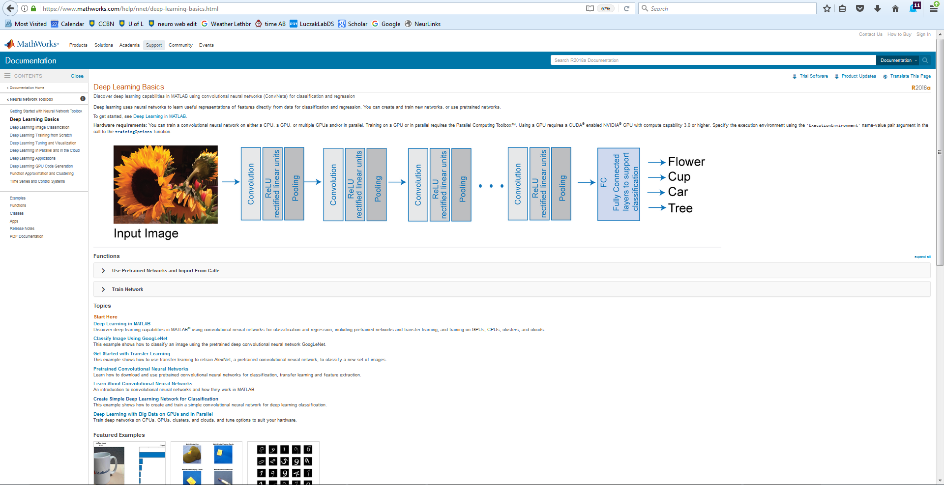

Slide 32
Applying Conv nets for electrophysiological signals
EEG / LFP
Spiking data

Slide 33
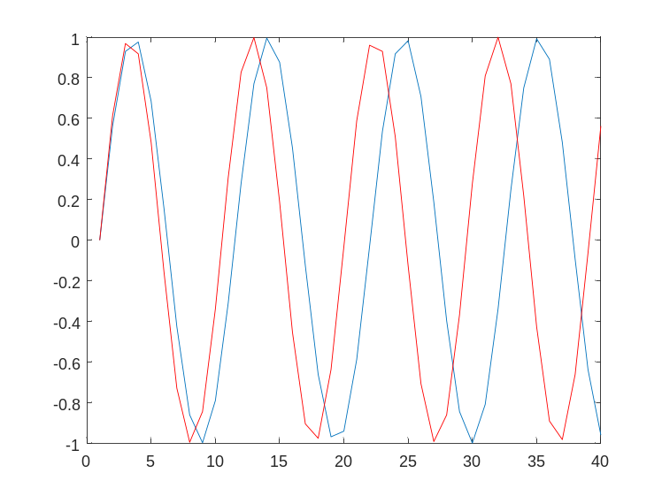
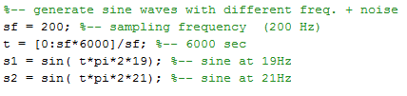
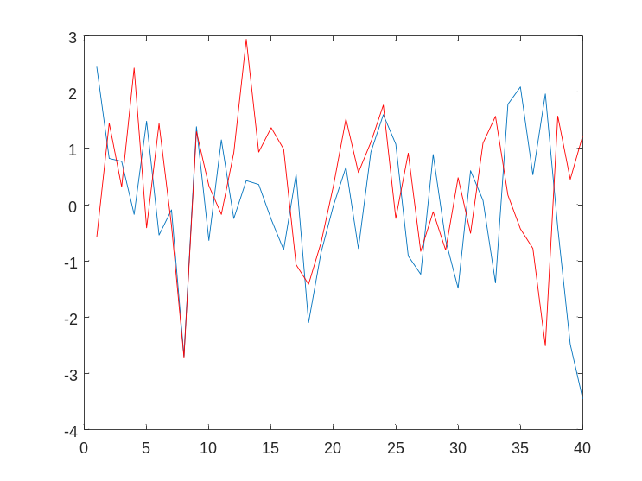

19Hz vs 21Hz
Generating LFP-like data to test Conv Net
ConvNeurNet_example.m
sin + noise

Slide 34
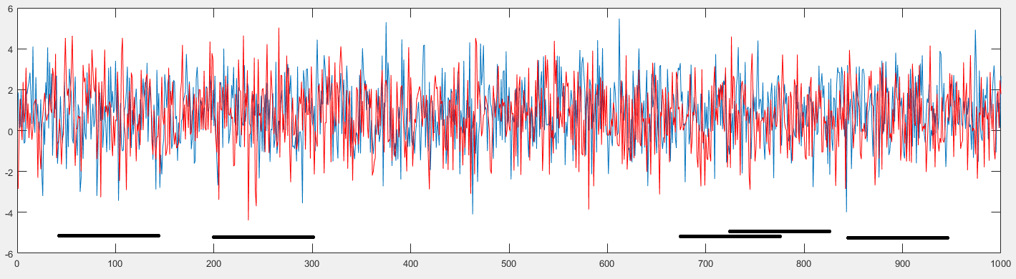
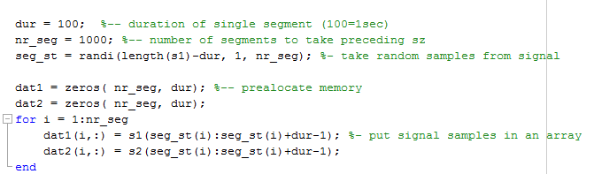
Taking segments of data for network training

Slide 35
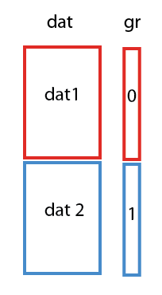
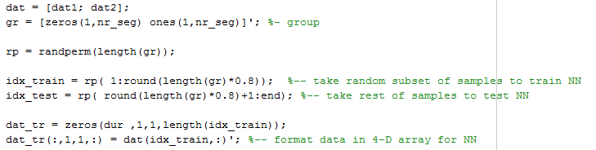
Combining data from both groups in one array
and taking randomly 80% of samples for training and 20% for testing

Slide 36
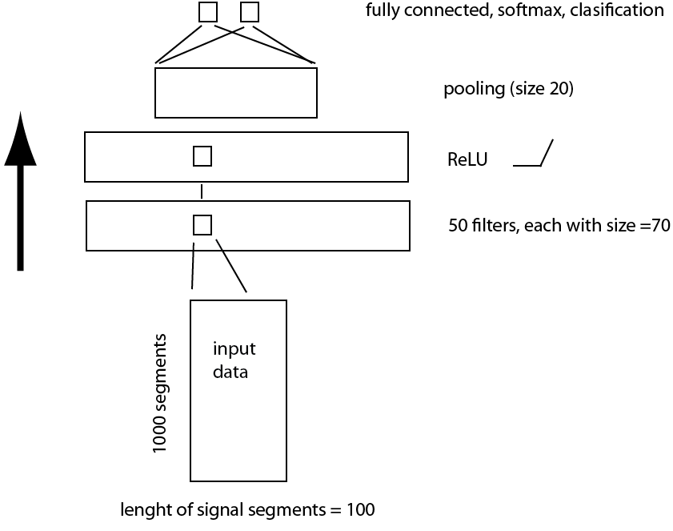
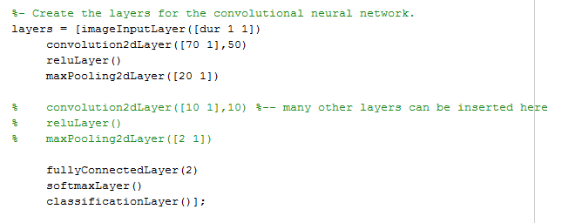
Our Conv Net architecture

Slide 37
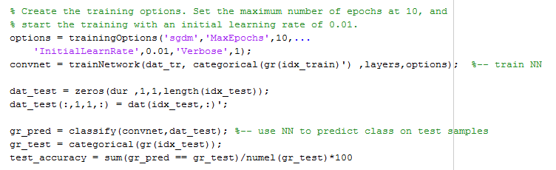
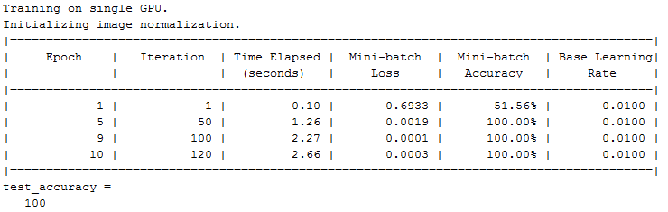
Training and testing our Conv net

Slide 38

Optional fine tuning

Slide 39




Two LFP-like signals with the same freq. but different phase locking
+ noise

Slide 40




More advanced DL frameworks
TensorFlow is an open source software library for numerical computation using data flow graphs. TensorFlow was developed by Google Brain Team to deploy machine learning and deep learning researches. The framework is written in C++ and Python. TensorFlow may stay as the most widely used framework in the DL for the next few years.
Keras was developed as an easily operated interface to simplify building neural networks with a speedy approach. It is written in Python and can be functioned on top of TenserFlow and Theano. It is more user-friendly and easy to use as compared to TensorFlow. Google may be including Keras in the next TenserFlow releases.
Caffe was was developed by Berkeley Artificial Intelligence Research. Caffe main application is in modelling Convolutional Neural Network (CNN). Following popularity of Caffe, Facebook introduced Caffe2 in 2017. Caffe2 framework offers users to use pre-trained models to build demo applications.
https://www.digitaldoughnut.com/articles/2018/february/a-comparison-of-deep-learning-frameworks

Slide 41
Python more popular than MATLAB
Python + Numpy + Scipy + Matplotlib is just as good as MATLAB. Python is open and free, it is very easy for other parties to design packages or other software tools that extend Python.
The expensive proprietary nature makes MATLAB difficult/ impossible for 3th parties to extend the functionality of MATLAB.
Mathworks puts restrictions on code portability. The standard library does not contain as much generic programming functionality, but does include matrix algebra and an extensive library for data processing and plotting.
If you want to experiment with some of the newest models for Machine Learning or Neural Networks, just use ScikitLearn and Keras + Tensorflow.
Python as a programming language is becoming more popular than MATLAB

Slide 42



Thank you
Discovery Accelerator Supplement

